Slide 1
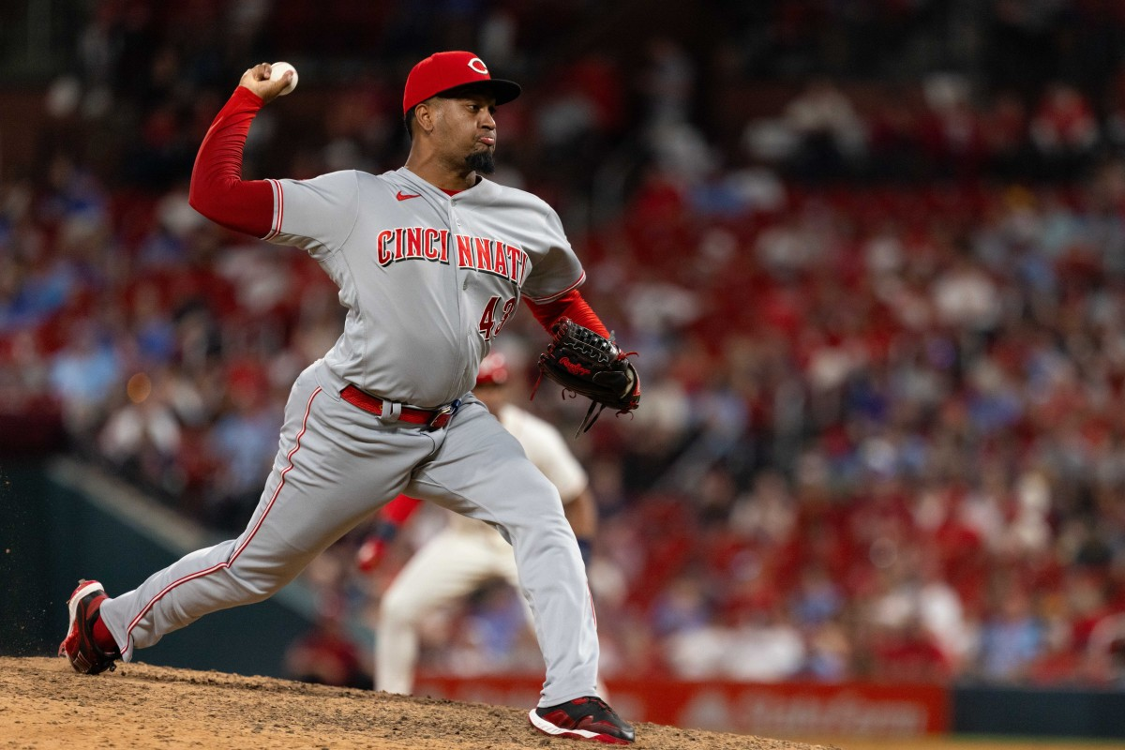

Exhibit on Behalf of Cincinnati Reds Organization:
Alexis Diaz
3.000 Major League Service Time
28 years old
Closing Pitcher
$4 Million Filing Number
Arbitration 1 Case
Jacob Wheat

Slide 2
Roadmap
CBA
Themes
Player Profile
Player Comparables
Why $4 Million is Justified

Slide 3
Collective Bargaining Agreement VI E.10
Criteria
Quality of Player’s Contribution to His Club
Overall Performance
Special Qualities of Leadership
Public Appeal
Recent Performance
Length of Consistency Throughout Career
Past Compensation
Physical or Mental Defects
Comparative Baseball Salaries

Slide 4
Themes
Comparison with the League
Mr. Diaz does not stand out compared to other closers in the league or year’s past
Regression and Lackluster Platform Year
Has not shown improvement since his 2023 breakout year
Player Comparables
Fits in with player comparables below the $4.5 million midpoint

Slide 5
Player Profile
Year | G | SV | BS | IP | ER | ERA | xERA | WHIP | AVG | OPS | K | BB | K/9 | BB/9 | K% | BB% | K-BB% | bWAR | fWAR | FIP | xFIP | IL
2024 (Platform Year) | 60 | 28 | 4 | 56.1 | 25 | 3.99 | 3.78 | 1.3 | .206 | .665 | 55 | 31 | 8.79 | 4.95 | 22.70% | 12.80% | 9.90% | 0.5 | 0.3 | 4.57 | 5.06 | 0
2023 | 71 | 37 | 3 | 67.1 | 23 | 3.07 | 3.4 | 1.19 | .186 | .597 | 86 | 36 | 11.5 | 4.81 | 30.10% | 12.60% | 17.50% | 1.8 | 1.8 | 3.52 | 4.2 | 0
2022 (Rookie Year) | 59 | 10 | 4 | 63.2 | 13 | 1.84 | 2.76 | 0.96 | .131 | .476 | 83 | 33 | 11.73 | 4.66 | 32.50% | 12.90% | 19.60% | 2.9 | 1.1 | 3.32 | 3.97 | 22
Total | 190 | 75 | 11 | 187.1 | 61 | 2.93 | 3.31 | 1.14 | .175 | .578 | 224 | 100 | 10.76 | 4.8 | 28.60% | 12.80% | 15.80% | 5.2 | 3.1 | 3.77 | 4.38 | 22
Salary
2025: $4,000,000
2024: $760,000
2023: $730,000
2022: $700,000
Recognition:
2023 NL All-Star
2022 5th NL Rookie of the Year

Slide 6
Player Profile
Career Best
Matches Career Best
Regression
Year | G | SV | BS | IP | ER | ERA | xERA | WHIP | AVG | OPS | K | BB | K/9 | BB/9 | K% | BB% | K-BB% | bWAR | fWAR | FIP | xFIP | IL
2024 (Platform Year) | 60 | 28 | 4 | 56.1 | 25 | 3.99 | 3.78 | 1.3 | .206 | .665 | 55 | 31 | 8.79 | 4.95 | 22.70% | 12.80% | 9.90% | 0.5 | 0.3 | 4.57 | 5.06 | 0
2023 | 71 | 37 | 3 | 67.1 | 23 | 3.07 | 3.4 | 1.19 | .186 | .597 | 86 | 36 | 11.5 | 4.81 | 30.10% | 12.60% | 17.50% | 1.8 | 1.8 | 3.52 | 4.2 | 0
2022 (Rookie Year) | 59 | 10 | 4 | 63.2 | 13 | 1.84 | 2.76 | 0.96 | .131 | .476 | 83 | 33 | 11.73 | 4.66 | 32.50% | 12.90% | 19.60% | 2.9 | 1.1 | 3.32 | 3.97 | 22
Total | 190 | 75 | 11 | 187.1 | 61 | 2.93 | 3.31 | 1.14 | .175 | .578 | 224 | 100 | 10.76 | 4.8 | 28.60% | 12.80% | 15.80% | 5.2 | 3.1 | 3.77 | 4.38 | 22
Salary
2025: $4,000,000
2024: $760,000
2023: $730,000
2022: $700,000
Recognition:
2023 NL All-Star
2022 5th NL Rookie of the Year

Slide 7
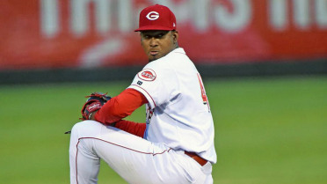
Durability
2022 (Rookie Year)
Retroactive July 16th-July 8th 15 Day IL, right biceps tendinitis (22 days)
Suspensions
N/A

Slide 8

Player Comparables

Slide 9

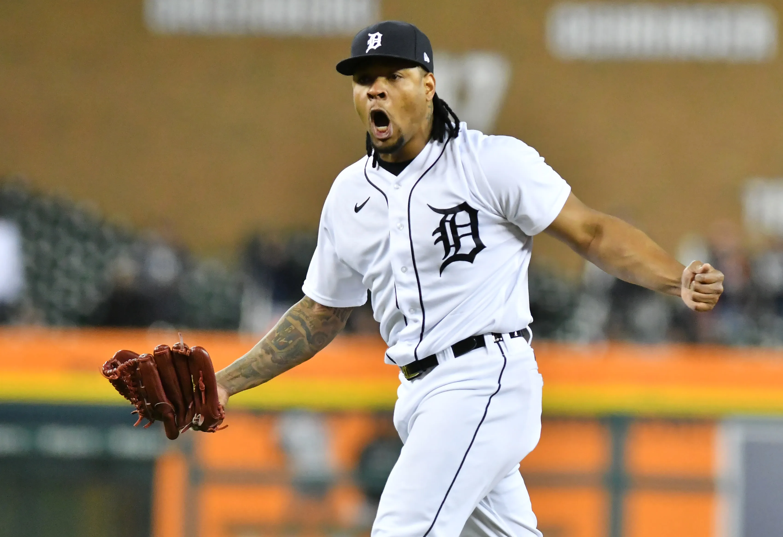
Gregory Soto
Arbitration Level 1 Salary: $3,925,000
Raise: $3,202,600
Pre-Arbitration Salary: $722,400
MLS: 3.102 Years
Platform Year: 2022
Recognition:
2022 NL All-Star
2021 NL All-Star

Slide 10
Diaz v. Soto Platform Year
Soto Salary: $3,925,000
Diaz Filing Number: $4,000,000
Player | G | IP | SV | ERA | xERA | WHIP | K/9 | K% | BB/9 | BB% | K- BB% | FIP | xFIP | bWAR | fWAR | IL
A. Diaz 2024 | 60 | 56.1 | 28 | 3.99 | 3.78 | 1.30 | 8.79 | 22.7% | 4.95 | 12.8% | 9.9% | 4.57 | 5.06 | 0.5 | 0.3 | 0
Soto 2022 | 64 | 60.1 | 30 | 3.28 | 4.08 | 1.38 | 8.95 | 22.8% | 5.07 | 12.9% | 9.9% | 3.59 | 4.59 | 0.1 | 0.6 | 0
A. Diaz Recognition:
2024 5th NL Saves
Soto Recognition:
2022 5th AL Saves
2022 AL All-Star
Comparable
Advantage

Slide 11
Diaz v. Soto Two-Year Comparison
Soto Salary: $3,925,000
Diaz Filing Number: $4,000,000
Player | G | IP | SV | ERA | xERA | WHIP | K/9 | K% | BB/9 | BB% | K- BB% | FIP | xFIP | bWAR | fWAR | IL
A. Diaz 2023-24 | 131 | 123.2 | 65 | 3.49 | 3.59 | 1.24 | 10.26 | 26.7% | 4.88 | 12.7% | 14.0% | 4.00 | 4.59 | 2.3 | 2.0 | 0
Soto 2021-22 | 126 | 124.0 | 48 | 3.34 | 3.84 | 1.36 | 9.87 | 25.2% | 5.37 | 13.7% | 11.5% | 3.88 | 4.45 | 1.5 | 1.0 | 16
A. Diaz Recognition:
2024 5th NL Saves
2023 3rd NL Saves
2023 NL All-Star
Soto Recognition:
2022 5th AL Saves
2022 AL All-Star
2021 9th AL Saves
2021 AL All-Star

Slide 12
Diaz v. Soto Career
Soto Salary: $3,925,000
Diaz Filing Number: $4,000,000
*2020 statistics not extrapolated
Player | G | IP | SV | ERA | xERA | WHIP | K/9 | K% | BB/9 | BB% | K- BB% | FIP | xFIP | bWAR | fWAR | IL
A. Diaz 2022-24 | 190 | 187.1 | 75 | 2.93 | 3.31 | 1.14 | 10.76 | 28.6% | 4.80 | 12.8% | 15.8% | 3.77 | 4.38 | 5.2 | 3.1 | 22
Soto 2019-22 | 186 | 204.2 | 50 | 4.13 | 4.44 | 1.49 | 9.23 | 23.0% | 5.28 | 13.1% | 9.9% | 4.29 | 4.71 | 2.0 | 1.1 | 16
A. Diaz Recognition:
2024 5th NL Saves
2023 3rd NL Saves
2023 NL All-Star
2022 5th NL Rookie of the Year
Soto Recognition:
2022 5th AL Saves
2022 AL All-Star
2021 9th AL Saves
2021 AL All-Star

Slide 13
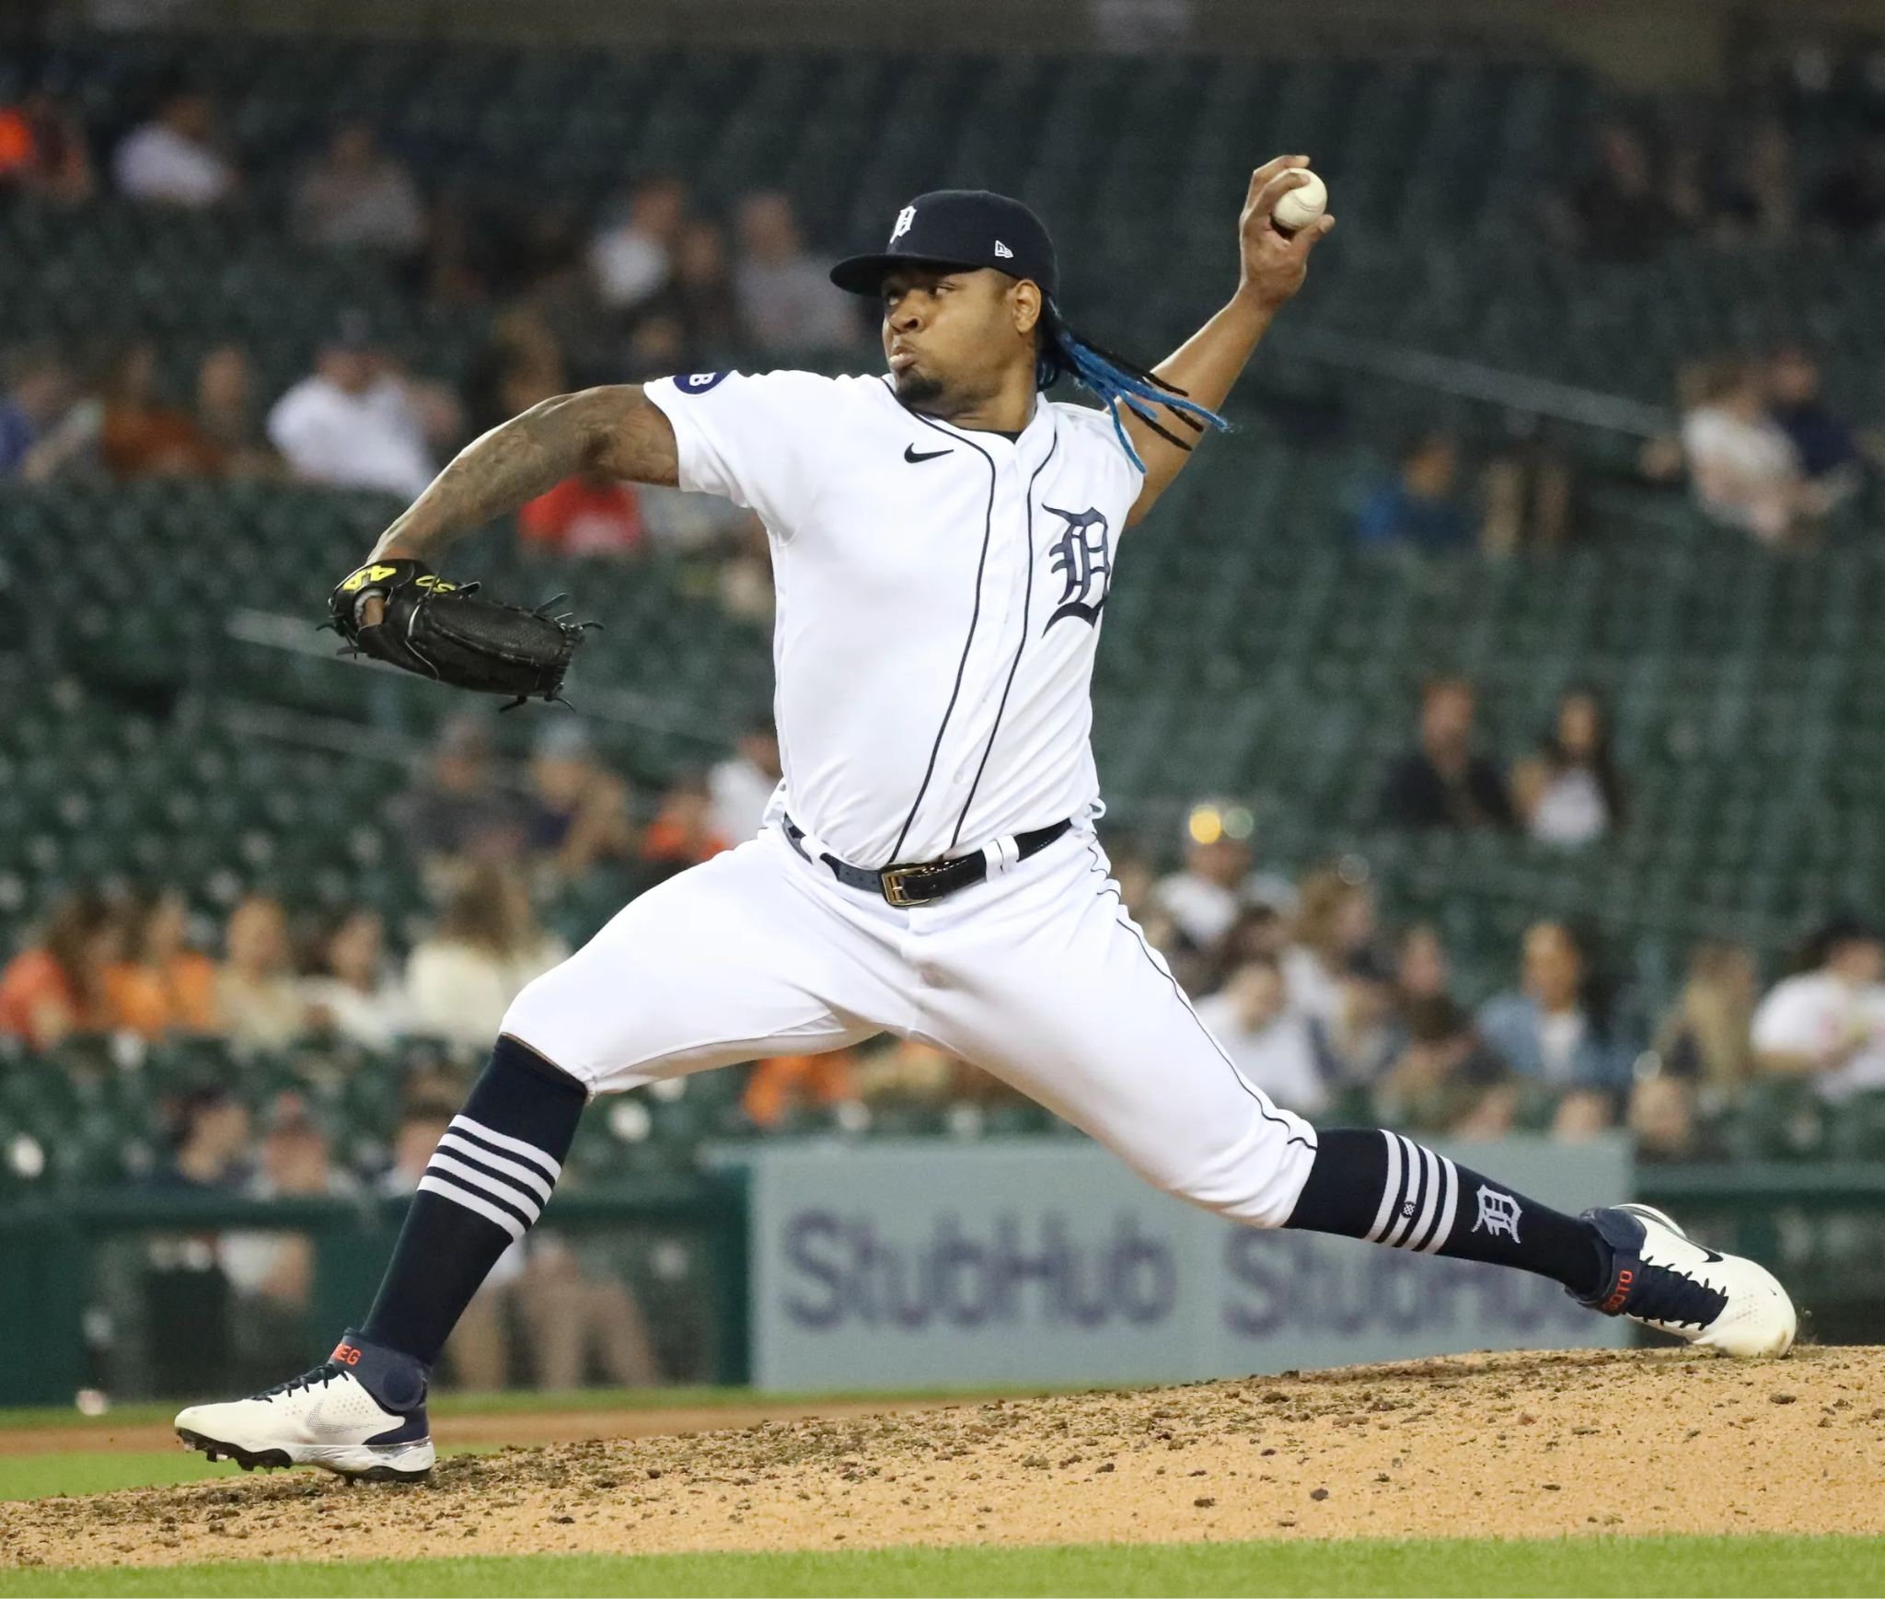
Durability
Injuries:
2021:
10-day IL, September 19th-October 5th, left finger fracture (16 days) (MLB.com)
Suspensions:
2019 (Minor League): Suspended 20 games without pay under Article XII(B) of the Basic Agreement for conduct detrimental or prejudicial to the sport (MiLB, Chris Bumbaca, January 11, 2019)

Slide 14


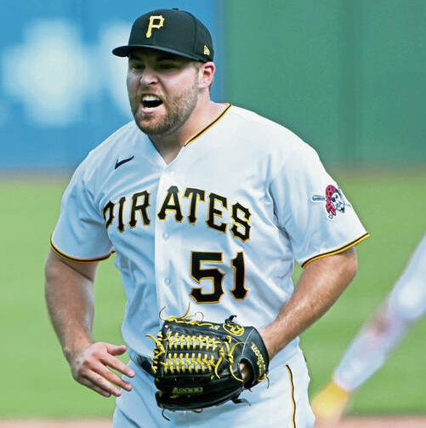
David Bednar
Arbitration Level 1 Salary: $4,510,000
Raise: $3,765,000
Pre-Arbitration Salary: $745,000
MLS: 3.076 Years
Platform Year: 2023
Recognition:
2023 NL All-Star
2022 NL All-Star

Slide 15
Diaz v. Bednar Platform Year
Bednar Salary: $4,510,000
Diaz Filing Number: $4,000,000
Player | G | IP | SV | ERA | xERA | WHIP | K/9 | K% | BB/9 | BB% | K- BB% | FIP | xFIP | bWAR | fWAR | IL
A. Diaz 2024 | 60 | 56.1 | 28 | 3.99 | 3.78 | 1.30 | 8.79 | 22.7% | 4.95 | 12.8% | 9.9% | 4.57 | 5.06 | 0.5 | 0.3 | 0
Bednar 2023 | 66 | 67.1 | 39 | 2.00 | 2.82 | 1.10 | 10.69 | 28.9% | 2.81 | 7.6% | 21.3% | 2.53 | 3.86 | 2.5 | 2.3 | 0
A. Diaz Recognition:
2024 5th NL Saves
Bednar Recognition:
2023 NL Saves Leader
2023 NL All-Star

Slide 16
Diaz v. Bednar Two-Year Comparison
Bednar Salary: $4,510,000
Diaz Filing Number: $4,000,000
Player | G | IP | SV | ERA | xERA | WHIP | K/9 | K% | BB/9 | BB% | K- BB% | FIP | xFIP | bWAR | fWAR | IL
A. Diaz 2023-24 | 131 | 123.2 | 65 | 3.49 | 3.59 | 1.24 | 10.26 | 26.7% | 4.88 | 12.7% | 14.0% | 4.00 | 4.59 | 2.3 | 2.0 | 0
Bednar 2022-23 | 111 | 119.0 | 58 | 2.27 | 3.02 | 1.11 | 11.27 | 30.6% | 2.80 | 7.6% | 23.0% | 2.49 | 3.42 | 3.8 | 3.7 | 47
A. Diaz Recognition:
2024 5th NL Saves
2023 3rd NL Saves
2023 NL All-Star
Bednar Recognition:
2023 NL Saves Leader
2023 NL All-Star
2022 10th NL Saves
2022 NL All-Star
2022 NL May Reliever of the Month

Slide 17
Diaz v. Bednar Career
Bednar Salary: $4,510,000
Diaz Filing Number: $4,000,000
*2020 statistics are not extrapolated
Player | G | IP | SV | ERA | xERA | WHIP | K/9 | K% | BB/9 | BB% | K- BB% | FIP | xFIP | bWAR | fWAR | IL
A. Diaz 2022-24 | 190 | 187.1 | 75 | 2.93 | 3.31 | 1.14 | 10.76 | 28.6% | 4.80 | 12.8% | 15.8% | 3.77 | 4.38 | 5.2 | 3.1 | 22
Bednar 2019-23 | 189 | 197.0 | 61 | 2.65 | 4.29 | 1.11 | 11.19 | 30.5% | 2.88 | 7.8% | 22.6% | 2.79 | 3.47 | 5.7 | 4.8 | 68
A. Diaz Recognition:
2024 5th NL Saves
2023 3rd NL Saves
2023 NL All-Star
2022 5th NL Rookie of the Year
Bednar Recognition:
2023 NL Saves Leader
2023 NL All-Star
2022 10th NL Saves
2022 NL All-Star
2022 May Reliever of the Month
2021 8th NL Rookie of the Year

Slide 18
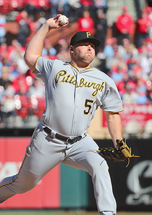
Durability
Injuries:
2022:
15-day IL, August 3rd (Retroactive July 31st) - September 22nd, low back pain (47 days) (MLB.com)
2021:
10-day IL, September 14th - September 26th, right oblique strain (12 days) (MLB.com)
2019 (Rookie Year)
7-day IL, May 6th (Retroactive May 3rd) - May 12th, non-specific injury (9 days) (MLB.com)
Suspensions:
N/A

Slide 19



Edwin Diaz
Arbitration Level 1 Salary: $5,100,000
Raise: $4,492,575
Pre-Arbitration Salary: $607,425
MLS: 3.121 Years
Platform Year: 2019
Recognition:
2018 AL Mariano Rivera Reliever of the Year Award
2018 All-Star
2018 8th AL Cy Young
2018 18th AL MVP
2016 5th Rookie of the Year

Slide 20
A. Diaz v. E. Diaz Platform Year
E. Diaz Salary: $5,100,000
A. Diaz Filing Number: $4,000,000
Player | G | IP | SV | ERA | xERA | WHIP | K/9 | K% | BB/9 | BB% | K- BB% | FIP | xFIP | bWAR | fWAR | IL
A. Diaz 2024 | 60 | 56.1 | 28 | 3.99 | 3.78 | 1.30 | 8.79 | 22.7 | 4.95 | 12.8% | 9.9% | 4.57 | 5.06 | 0.5 | 0.3 | 0
E. Diaz 2019 | 66 | 58.0 | 26 | 5.59 | 3.23 | 1.38 | 15.36 | 39.0% | 3.41 | 8.7% | 30.3% | 4.51 | 3.07 | -0.6 | 0.0 | 0
A. Diaz Recognition:
5th NL Saves
E. Diaz Recognition:
9th AL Saves

Slide 21
A. Diaz v. E. Diaz Two-Year Comparison
E. Diaz Salary: $5,100,000
A. Diaz Filing Number: $4,000,000
Player | G | IP | SV | ERA | xERA | WHIP | K/9 | K% | BB/9 | BB% | K- BB% | FIP | xFIP | bWAR | fWAR | IL
A. Diaz 2023-24 | 131 | 123.2 | 65 | 3.49 | 3.59 | 1.24 | 10.26 | 26.7% | 4.88 | 12.7% | 14.0% | 4.00 | 4.59 | 2.3 | 2.0 | 0
E. Diaz 2018-19 | 139 | 131.1 | 83 | 3.56 | 2.56 | 1.05 | 15.28 | 41.8% | 2.67 | 7.3% | 34.5% | 2.89 | 2.35 | 2.5 | 3.5 | 0
A. Diaz Recognition:
2024 5th NL Saves
2023 3rd NL Saves
2023 NL All-Star
E. Diaz Recognition:
2019 9th AL Saves
2018 Led MLB Saves (57)
2018 AL Reliever of the Year
2018 8th AL Cy Young
2018 18th AL MVP
2018 AL All-Star
2018 April, June, July, August Reliever of the Month

Slide 22
A. Diaz v. E. Diaz Career
E. Diaz Salary: $5,100,000
A. Diaz Filing Number: $4,000,000
Player | G | IP | SV | ERA | xERA | WHIP | K/9 | K% | BB/9 | BB% | K- BB% | FIP | xFIP | bWAR | fWAR | IL
A. Diaz 2022-24 | 190 | 187.1 | 75 | 2.93 | 3.31 | 1.14 | 10.76 | 28.6% | 4.80 | 12.8% | 15.8% | 3.77 | 4.38 | 5.2 | 3.1 | 22
E. Diaz 2016-19 | 254 | 249.0 | 135 | 3.33 | 2.59 | 1.10 | 14.46 | 38.9% | 3.11 | 8.4% | 30.5% | 3.01 | 2.67 | 4.8 | 6.4 | 0
E. Diaz Recognition:
2019 9th AL Saves
2018 Led MLB Saves (57)
2018 AL Reliever of the Year
2018 8th AL Cy Young
2018 18th AL MVP
2018 AL All-Star
2018 April, June, July, August Reliever of the Month
2017 4th AL Saves
2016 5th AL Rookie of the Year
A. Diaz Recognition:
2024 5th NL Saves
2023 3rd NL Saves
2023 NL All-Star
2022 5th NL Rookie of the Year

Slide 23

Durability
Injuries:
N/A
Suspensions:
N/A

Slide 24
Why $4 Million is Justified
Midpoint: $4,500,000
A. Diaz (3.000 MLS) $4,000,000 Filing Number
Demonstrated regression throughout career across the board
Soto 2022 (3.102 MLS) $3,925,000
Nearly identical platform season and comparable two-year comparison
Award a $75,000 increase for career performance and clean record
Bednar 2023 (3.076 MLS) $4,510,000
Lags behind in statistics across the board
E. Diaz 2019 (3.121 MLS) $5,100,000
Lacks pedigree
Has not demonstrated a $5,000,000 ceiling
Large Disparity in ball control (K and BB %)

